Slide 1


ICU PREDICTION OF COVID-19 PATIENTS
PRESENTED BY
NIDHI CHANDRAMOHAN
PRITHIVIRAJ MANIRAM
PADMA DEEPIKA NARAYANASWAMY
Sahiti ADDANKI

Slide 2
PROBLEM STATEMENT
Predict the chances of ICU admission of covid 19 patient based on various test results.
By this information hospitals can plan the flow of operations and take critical decisions like shifting patient to another hospital or arrangement of resources within the time so that the lives of patients can be saved.

Slide 3
Data Sources
https://www.kaggle.com/abhinavaravindan/covid-icu-admit-prediction

Slide 4
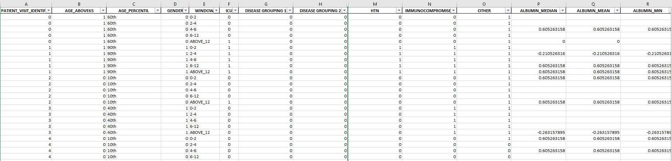
SNAPSHOT OF ORIGINAL DATASET
230 Predictors and 1925 Observations
Source : Kaggle

Slide 5
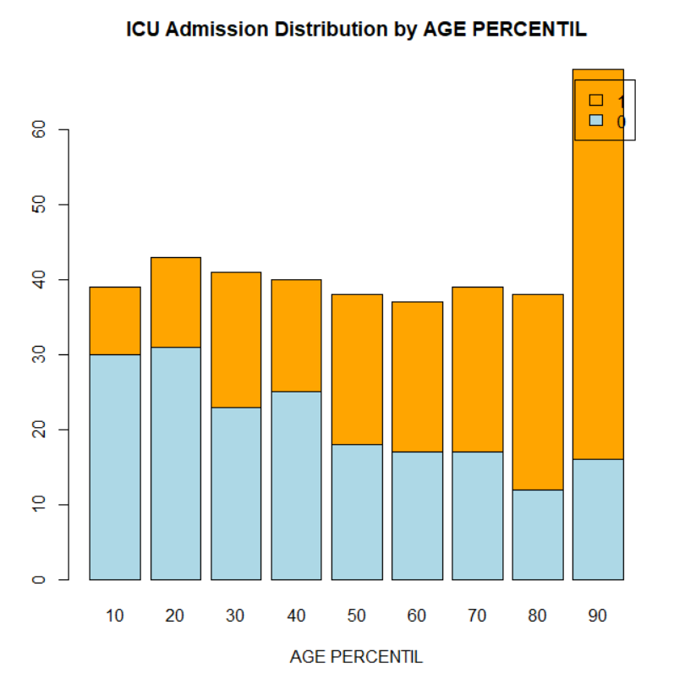
AGE PERCENTILE vs ICU ADMISSIONS

Slide 6
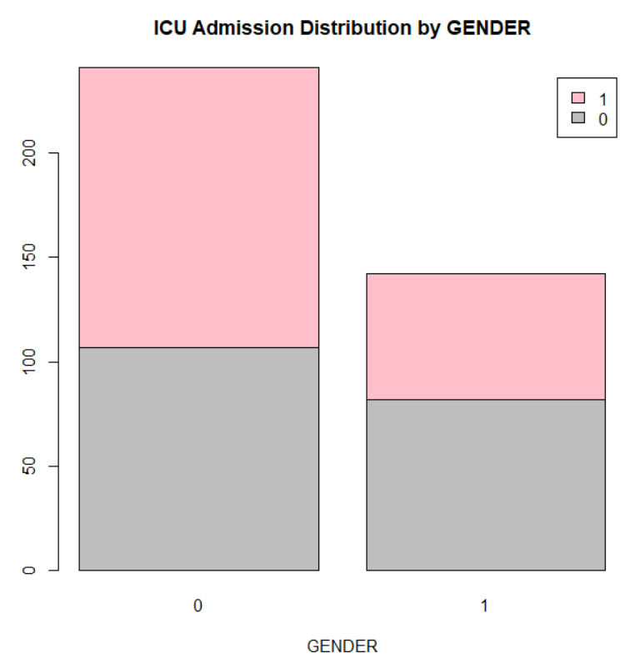
GENDER vs ICU ADMISSIONS

Slide 7
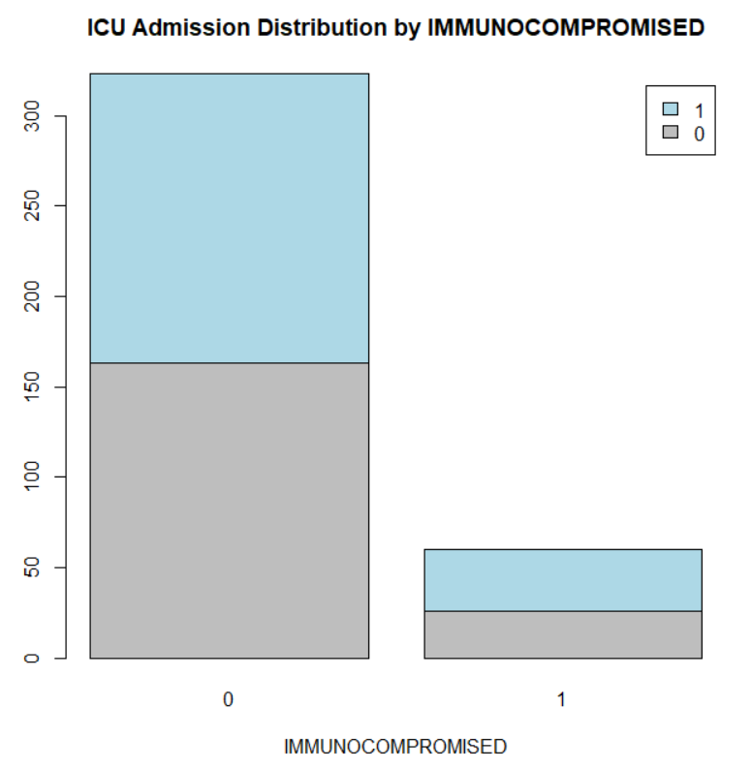
ICU Admission vs Immuno compromised

Slide 8
DATA CLEANING / TRANSFORMATION
Five rows for one patient – changed to one row per patient using mean of data from values from that patient
Transformed string values in columns “AGE_PERCENTIL” to numeric
Dropped unwanted columns - PATIENT_VISIT_IDENTIFIER, WINDOW, OTHERS

Slide 9
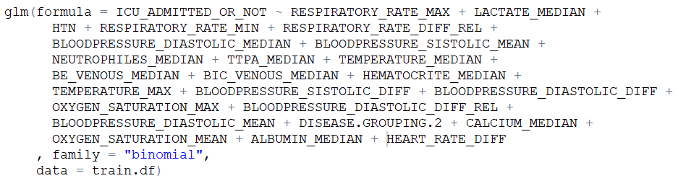
VARIABLE SELECTION - STEPWISE
230 to 25 Predictors

Slide 10

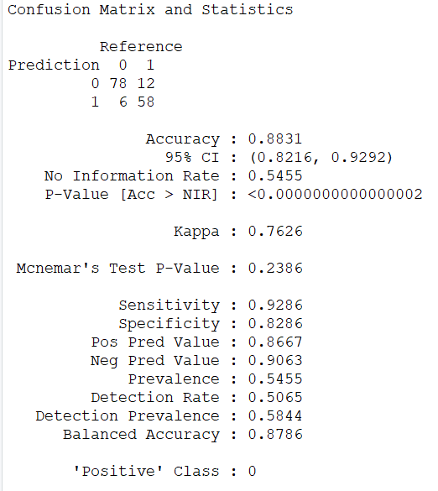



Logistic Regression

Slide 11
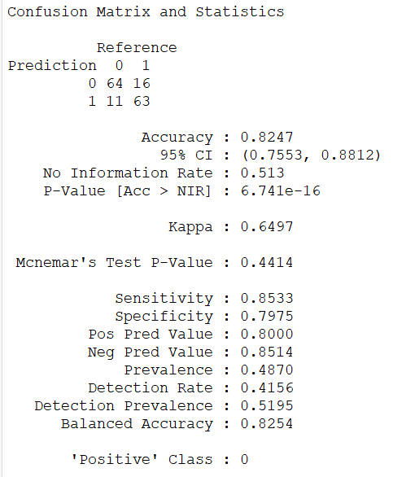
Naïve Bayes Model

Slide 12
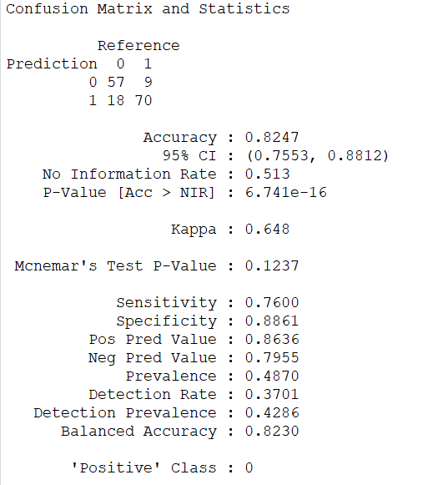
Classification Tree

Slide 13
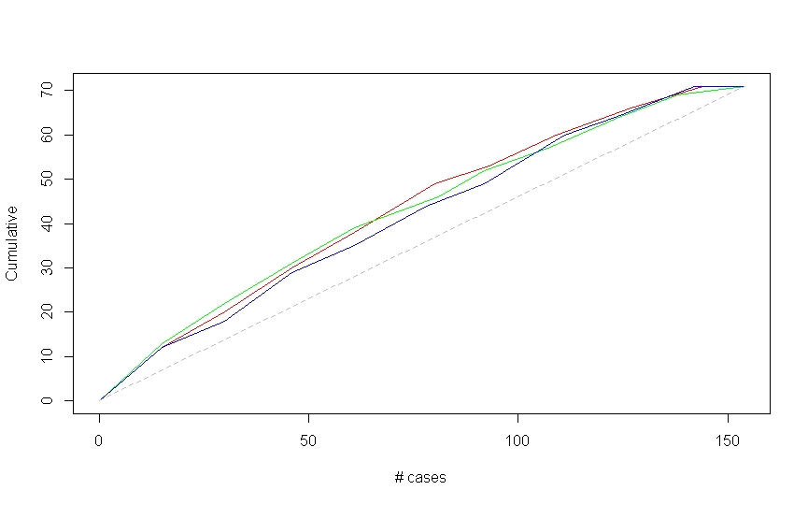
Lift Chart

Slide 14
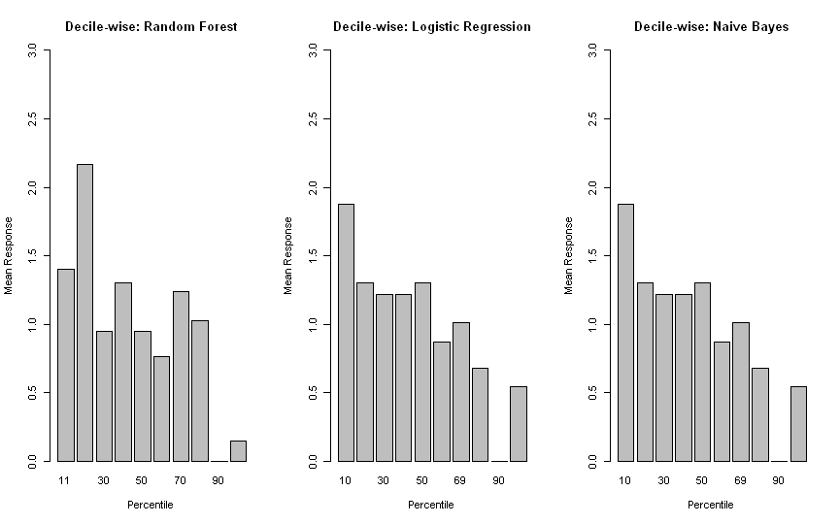
Decile Chart

Slide 15
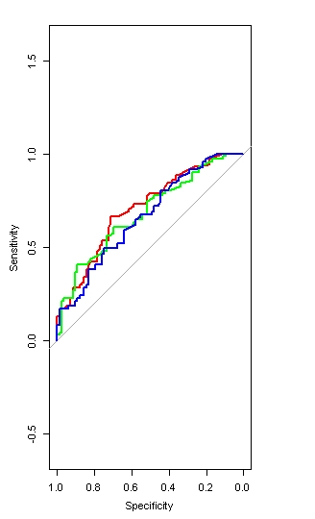
Receiver operating characteristic curve

Slide 16
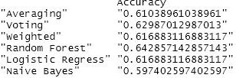
Ensemble using Weighted Average
Random forest shows the highest accuracy out of all

Slide 17
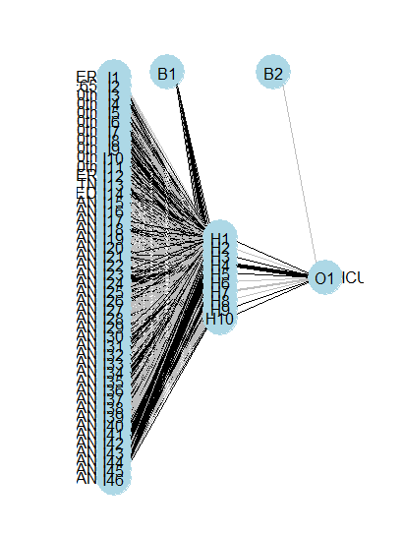
Neural Network

Slide 18
Observation
Random forest provides best prediction based on the analysis
More information on disease grouping in the original dataset would have improved accuracy
Geographical location and Population density would have provided more information on the severity of the spread and possible infection.
Fully vaccinated information will also have significant impact on the outcome.
Mitigation measures from developing vs developed nations will also significant impact on the outcome.

